Slide 1


©
John Parkinson

Slide 2
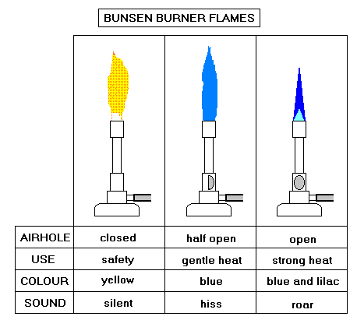

BANG
HEAT ENERGY
LET THERE BE HEAT !!
©
John Parkinson

Slide 3
SPECIFIC HEAT CAPACITY
The HEAT CAPACITY of a body is the energy required to raise its temperature by one degree Celsius [C]
[or one degree K]
c
The SPECIFIC HEAT CAPACITY of a material is the energy required to raise the temperature of ONE KILOGRAM of the material by one degree Celsius [C]
[or one degree K]
SPECIFIC HEAT CAPACITY
SPECIFIC HEAT CAPACITY
ONE KILOGRAM
UNITS = J kg⁻¹ K⁻¹
©
John Parkinson

Slide 4
SOME SPECIFIC HEAT CAPACITIES
substance | c / J kg⁻¹ K⁻¹
water
4200
ice
2100
copper
380
iron
480
aluminium
900
ethanol
2500
paraffin
2140
olive oil
1970
air
1000
©
John Parkinson

Slide 5

Final
Temperature
T₂
Initial Temperature
θ₁
ΔQ = m c ΔT
Mass m
ΔQ
JOULES
ADDED
ΔQ = m c [ T₂ - T₁]
©
John Parkinson

Slide 6
QUESTION 1
WHAT WILL BE THE TEMPERATURE OF THE WATER AFTER 2 MINUTES?
SPECIFIC HEAT CAPACITY OF WATER IS 4200 J kg⁻¹ K⁻¹
2 kW
immersion heater
ΔQ = 2000 Joules/second x 2x60 seconds
= 240 000 Joules
ΔQ = m c Δθ
240 000J = 2 kg x 4200J/kg/K x Δθ
2000 g of water
Δθ = 28.6 K
At 20⁰ C
Final Temperature = 20 + 28.6 = 48.6⁰ C
In reality the final temperature will be lower than this. WHY?
(i) Heat lost to surroundings
(ii) Heat absorbed by the vessel
©
John Parkinson

Slide 7
QUESTION 2
The two disk brakes of a 600 kg motorbike each have a mass of 1 kg.
The motorbike brakes to a stop from 30 m s⁻¹.
If 50 % of the bike’s kinetic energy is transferred to the the disks, calculate their rise in temperature. c = 500 J kg⁻¹ K⁻¹
Kinetic Energy of Bike
Heat energy in Brake Disks
½ M v²
=
m c Δθ
50% of [½ x 600 x 30²] = [2x1] x 500 x Δθ
Δθ = 135 K
©
John Parkinson

Slide 8

THE GULF STREAM OR NORTH ATLANTIC DRIFT PRODUCES A MILD CLIMATE FOR THE BRITISH ISLES
Water in the Gulf of Mexico starts off at between 25 and 30⁰C
Because water has a high specific heat capacity, it takes a long time to cool.
Even in winter the seas to the west of the
British Isles are rarely below 8⁰C
©
John Parkinson

Slide 9
RADIATOR
Why is Water used as the coolant?
Because water has a high specific heat capacity, it can take away a lot of energy without boiling away.
©
John Parkinson

Slide 10
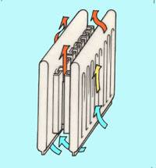
Domestic Radiators are operated using water
Apart from its cheapness and availablity, why is water used ?
Because water has a high specific heat capacity, it can carry a lot of energy.
©
John Parkinson

Slide 11


ONSHORE AND OFFSHORE BREEZES
By day the land heats up faster than the sea.
Why?
The land has a lower specific capacity than the water.
The land heats the air from below and convection currents rise
This drags in cooler air from over the sea – On Shore Breeze
The reverse happens by night
©
John Parkinson

Slide 12
QUESTION 3
200 g of water at 10⁰C is added to 400 g of water at 50⁰C in an a 200 g metal can of specific heat capacity 400 Jkg⁻¹K⁻¹. What will be the temperature of the water immediately after thorough mixing has occurred? { C_{water} = 4200 Jkg⁻¹K⁻¹ }
Heat lost by the hot water and the can = Heat gained by the cold water
m c Δθ_{hot water}+ m c Δθ_{can} = m c Δθ_{cold water}
Let θ = the final temperature
Can and water at 50⁰ C
0.4 x 4200 x [50 - θ] + 0.2 x 400 x [50 - θ] = 0.2 x 4200 x [θ - 10]
θ
θ = 37.1 ⁰
Cold water at 10⁰ C
©
John Parkinson

Slide 13
HEATING A SOLID
When the temperature stops rising, melting has begun
Temperature
M Pt
Liquid
Liquid +
Solid
Solid
Time
The temperature rises again when all the solid has melted
Where has the energy supplied gone whilst the temperature is constant?
The Specific Latent Heat of Fusion of a Solid is the energy which has to be supplied in order to convert 1 kg of the Solid completely into a Liquid
©
John Parkinson

Slide 14
Bring a Liquid to the Boil
Temperature
Gas
B Pt
Gas +
Liquid
Liquid
Time
The Specific Latent Heat of Vaporisation of a Liquid is the energy which has to be supplied in order to convert 1 kg of a Liquid completely into Vapour at the Boiling Point of the Liquid, and at Standard Atmospheric Pressure
©
John Parkinson

Slide 15

Specific Latent Heat
UNITS
JOULES per KILOGRAM
J kg ⁻¹
FORMULA
ΔQ = m L
©
John Parkinson

Slide 16
Substance | L / J kg⁻¹
STEAM Latent Heat of Vaporisation of Vaporisation | 2 250 000 2 250 000
ICE Latent Heat of Fusion | 336 000
QUESTION 4
A 2 kW kettle holds 2 litres of water, initially at 20 ⁰C
How long will it be before a quarter the water has boiled away, assuming that there are no heat losses?
To raise the water from 20 to 100⁰C needs m c Δθ Joules= 2 x 4200 x 80 = 672 000J
This takes 672 000 ÷ 2000 = 336 seconds
To boil away 0.5 kg of th water requires Q = mL joules = 0.5 x 2 250 000 J
= 1 125 000 J
This takes 1 125 000 ÷ 2000 = 562.5 seconds
t
t
t
TOTAL TIME = 336 + 562.5 = 898.5 seconds
©
John Parkinson

